Slide 1

Introduction to Python programming
Gal Rattner

Slide 2
Outlines
What is python?
Installation
Conda
Virtual environments & Interpreters
Packages
Syntax
Functions
Examples
Links
Notes:
So why doing text prediction?

Slide 3
What is python?
Python is a dynamic (compiled at runtime) programming language, gaining huge popularity in the recent years
Created in 1991 by Guido van Rossum
It is open source – packages are developed and released by programmers frequently
There are two main versions to python:
Python 2.x (late is 2.7) – will be deprecated by 2020
Python 3.x (3.5/3.6/3.7) - mainly used
Easy to learn – mainly used for server programming, mathematics (replacing matlab), ML etc.
Notes:
You should use only 3.5 and above.
Except some Image processing packages – didn’t see anything that doesn’t exist in 3.5 ^

Slide 4
Installation
Installation can be done in few ways:
Python.org
Anaconda3 – managing installation of packages
Pycharm – JetBains Integrated Development Environment (IDE) for python
We will install Conda and open Virtual environment
Then we will install pycharm and define the environment as the project interpreter

Slide 5

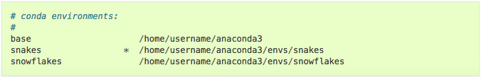
Installation
Installing Anaconda3
https://conda.io/docs/user-guide/install/windows.html#install-win-silent
Pay attention that you install with the proper 3.x python version
Using CMD prompt:
The environments can be switched using ‘activate <name>’ , ‘deactivate <name>’
The * signify which env is now active

Slide 6

Installation
Installing Pycharm
Pycharm is one of the common IDEs (like MS Visual Studio for example)
It is very comfortable and adjusted for remote connection and ML development
Installation link:
https://www.jetbrains.com/help/pycharm/install-and-set-up-pycharm.html
Make sure to install the full version and not ‘community edition ’ (CE) for remote control ability.

Slide 7
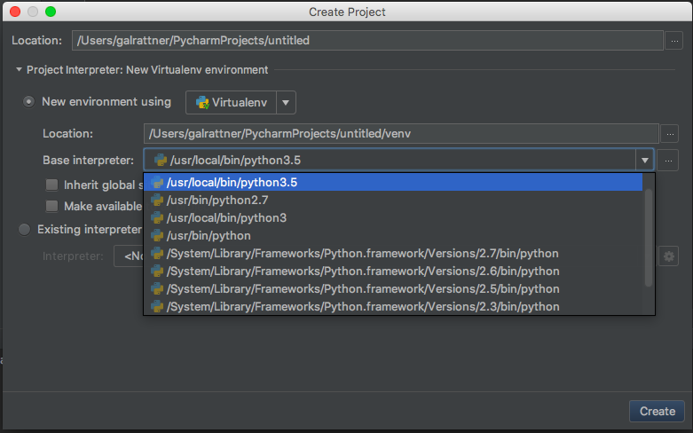
Installation
Open a new project and select the ‘interpreter’ to be the conda virtual env you created.
or in: File → settings → project interpreter

Slide 8

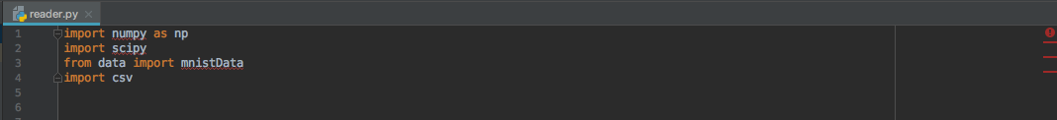
Python packages
The basic Python language is very thin and shallow Extensions are added manually to each project as ‘import <package>’ command
Import should be used at the top of each python script file
Some of the common packages
numpy – dealing with numbers and mathematics
pickle – save/load files
os - operations on files (move/remove/create)
time - times calculation
tensorflow/torch – ML packages
*You can import a class/subpackage from a package, or rename an imported package

Slide 9
Python packages
One of the most important packages for research work is numpy
numpy has many Matlab-like functions and operators
np.ones(100,10)
np.squeeze()
np.linspace()
Etc.
Use shortcut:
import numpy as np
All mathematics and vector operations should be done ONLY using np, for efficiency and preciseness
Python math operations often include substantial errors

Slide 10

Python syntax
Python data structures
list – the basic array structure in python, bound with [], can contain more than one data types
[1, 2, 4, ‘stam_string’, 8, 16]
np.array -- the numpy array type, used for vector/matrix math
dictionary – complex data structure that stores “keys” and their ‘values’
{”name” : ‘gal’, ”age” : 29, “occupation” : ‘researcher’}
Syntax
Indentation !!!
Data copying – make sure to use ‘copy’ package to deep copy non scalar data objects
Make sure not to use saved words as variables names (in, list, len, etc.)
dot dot colon ‘ : ’
Notes:
Object oriented programmin

Slide 11
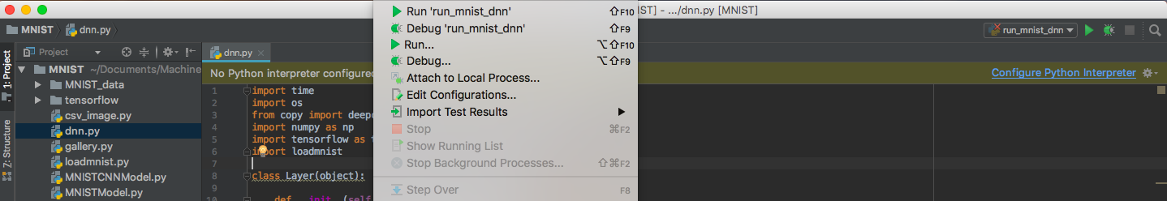
Python tips
OOP – define classes and call them to create objects
init() functions
Properties (@propery)
private functions – for effective and easy coding
Use vectorization of the calculation (instead of for loops) – reduces runtime by 1-2 orders
Use global variables to use common data between functions
Use pycharm debug mode all the time!
Notes:
Object oriented programmin

Slide 12
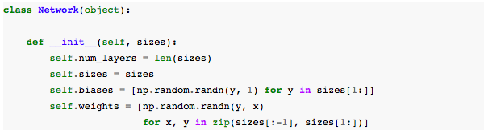
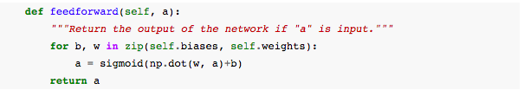
Examples
Notes:
Object oriented programmin

Slide 13
Questions

Slide 14
Links
Python tutorials:
https://www.w3schools.com/python/python_getstarted.asp
https://www.learnpython.org/
Conda:
https://conda.io/docs/user-guide/getting-started.html
Pycharm:
https://www.jetbrains.com/pycharm/documentation/
Linux tutorial (for server work):
https://www.tutorialspoint.com/unix/
Michael Nielsen ML book & examples:
http://neuralnetworksanddeeplearning.com/chap1.html
Notes:
Object oriented programmin

